Slide 1
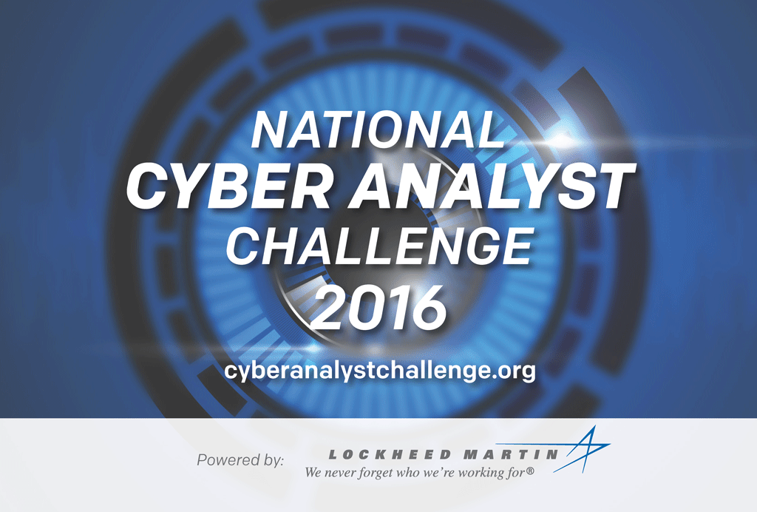
University (name)
Team members (names)
Faculty advisor (names)

Slide 2
Phase I Challenge
We have been asked by a foreign government to conduct an Incident Response (IR) assessment on their government assets. See the appendices for details and tips.
We are scheduled to deliver an analysis to senior representatives of the government on the details of the incident, analysis of how it occurred, and recommendations for moving forward.
Use this PowerPoint template to prepare the analysis. This is your deliverable for Phase I.
Limit the response to 10 slides excluding the title slide and any appendices. Note: There is no guarantee that appendices will be reviewed. Remove this slide and the existing appendix from your response.

Slide 3
Findings and Potential Impacts
What problems did you find?

Slide 4
Suggestion on Mitigations
List and justify your suggested solutions

Slide 5
Tools and Process
What tools did you use?
Describe your process.
Why?

Slide 6
What did you learn?
List and explain what you learned from this case

Slide 7
Appendix A - Instructions
During the initial incident response, several items of concern were identified by the team that may or may not be related. The IR activities performed by your team will include forensic examination of artifacts collect by a government representative during the IR activity. Your team will follow the Rules of Engagement (ROE) as established in this document.
All supplied artifacts are to be considered controlled and can only be viewed and analyzed by authorized team members.
Examination of the compromised system is not authorized nor is it available. Examination is limited to supplied artifacts only.
The Dropbox folder contains the following files, some editing has been done to the information in the files for legal purposes. No additional artifacts will be supplied.
Exported Registry Report in PDF
Exported Master File Table in CSV format
All event logs containing data in CSV format
Various system logs
Prefetch files in the original .PF format
Various screen captures
Some data has been renamed or removed due to the sensitive nature of the data and the customer base
In the CSV logs you may see a field “Container Log.” This field can be ignored as it is a reference to the location of the original .EVTX logs during conversion to CSV.

Slide 8
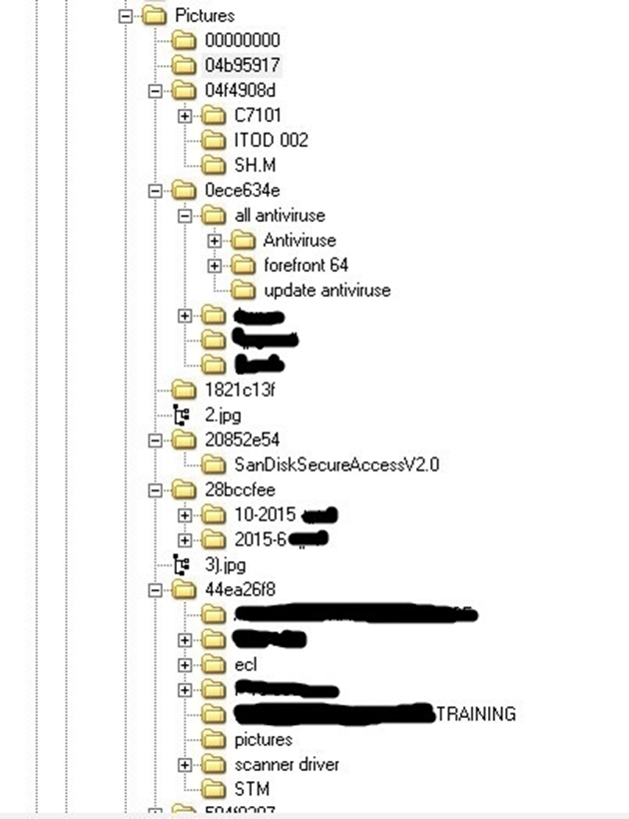
Appendix B - Indicators
New unknown hidden folders found in the users picture folder.
Traffic was seen from the computer to an unknown destination with encrypted traffic.
Date and time stamps seem to be inconsistent with activity.

Slide 9
Appendix C - Tips
The committee will evaluate the submission for presentation, incident analysis/content, and technical skills. All three are important.
Presentation is assessed on clarity, directness, engagement, and use of relevant visual or textual aids.
Incident analysis / content is assessed on identifying most of the aspects of the incident, prioritizing important threats, and using appropriate judgement.
Technical skills is assessed on possessing and applying appropriate technical tools and concepts, ability to self-direct and learn skills as needed, and demonstration of mastery in key underlying areas such as analytics, networking, cyber-forensics, etc.

